Slide 1

Security Analysis of the
Internet Architecture
Master Thesis - Marco Seewer
Supervised by Roland Meier, Jordi Nieto, and Adrian Perrig
This research is supported by armasuisse Science and Technology.

Slide 2
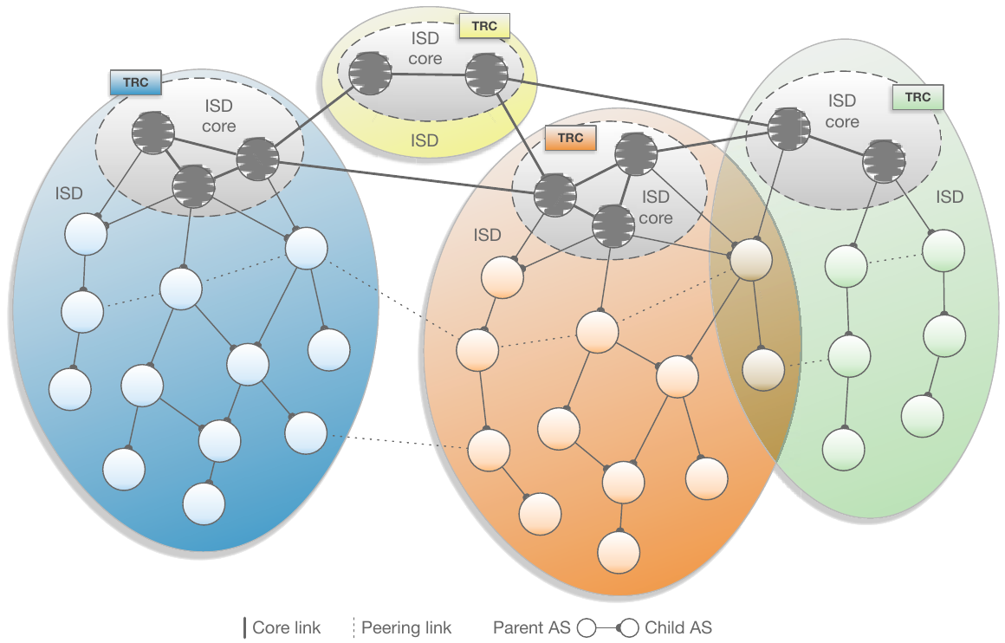
SCION Features
Isolation domain (ISD):
Fault + trust isolation
Control:
Path
Scalability:
Forwarding
The Complete Guide to SCION, Figure 2.1
Notes:
ISD: country
Isolate (no global kill switch→ BGP prefix hijack)

Slide 3

Scalability, Control, and Isolation on Next-Generation
Networks
Developed at ETH Zurich
Open-Source
Commercialized by

Slide 4


SWITCH
AS: 559
Setup CYD Testbed:
3 ASes
3 Core ASes
  SCION Production Network
Anapaya Routers
  3 operational
  1 offline test device
Swisscom
AS: 3303
Sunrise
AS: 6730
Zurich AS:
2:0:2b
Thun AS:
2:0:2c
Lausanne AS:
2:0:2d
Notes:
Anapaya SW:
- own BR + Gateway

Slide 5

WHY?

Slide 6


Problem
SCION protocol implementation:
Anapaya version Open-source version
Anapaya devices
Notes:
Operational devices

Slide 7


Focus
Security of Operational Devices
SCION Network in use
Impact of Traditional Internet on SCION
Notes:
Operational devices

Slide 8

Process
Independent security analysis
Disclosure with Anapaya
Software updates
Approval for publication/presentation
Attacker models:
  SCION end-host
  On-path
  Off-path
  Non-SCION adversary

Slide 9

1) Anapaya’s SCION device

Slide 10
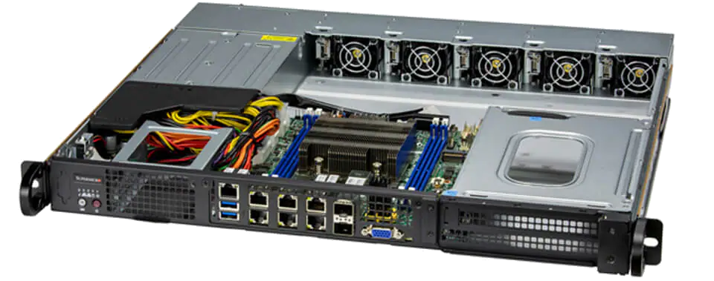
Anapaya Device
Unauthenticated + authenticated vulnerability scans
Scan results applicable (threat model: No local access)
Compliance scans
Docker images
Exposure of systemd services
SSH configurations
Open ports + running services
SCION configuration (Management system)
https://www.supermicro.com/files_SYS/images/System/SYS-110D-8C-FRAN8TP_main.jpg
Notes:
Operational devices
Automated scans + manual investigation

Slide 11

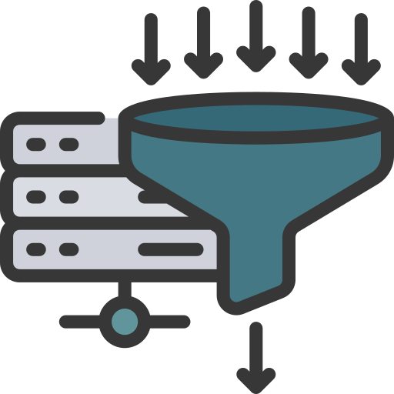
SSH Configuration
Only public-key authentication
Some less secure algorithms enabled
No rate limiting → DHEat attack:
  Send many DH keys (or random big numbers)
  Expensive modular exponentiation → CPU
Notes:
Operational devices
Automated scans + manual investigation

Slide 12


On Device Security
Outdated + vulnerable software (need local access to exploit)
Driver of Intel Ethernet Controller (Privilege escalation)
→ Potentially remotely exploitable
Distroless Debian (still contains vulnerable openssl version)
→ cmd injection, use-after-free, double-free, DoS
Notes:
Operational devices
Automated scans + manual investigation

Slide 13
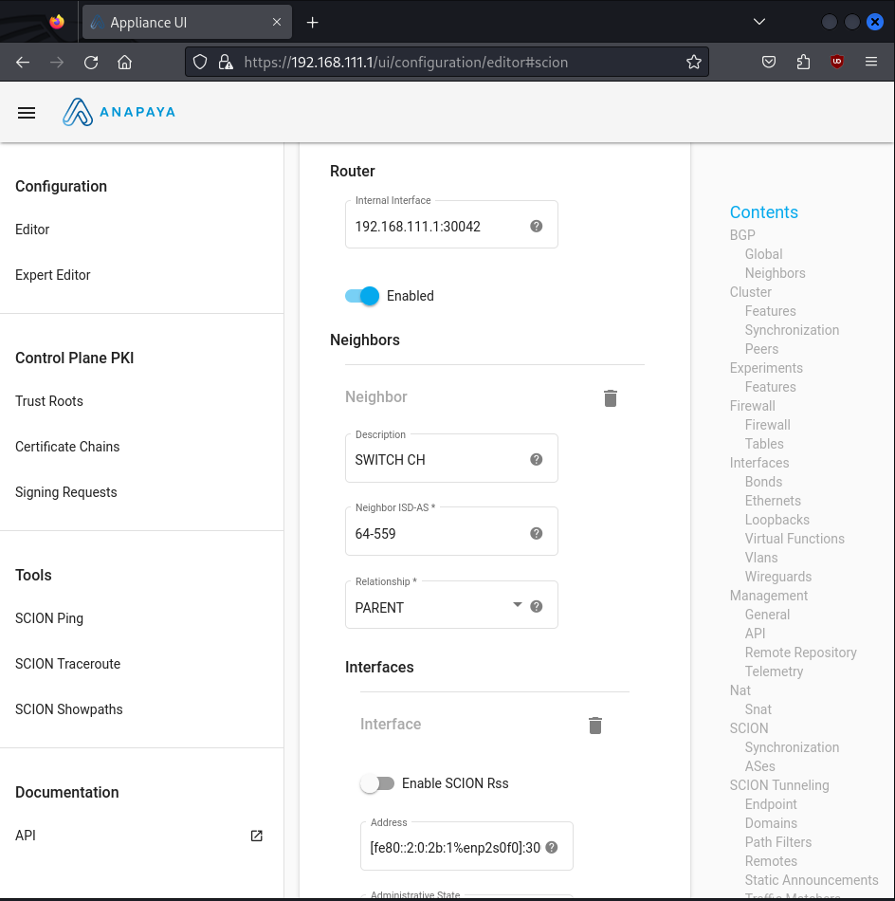


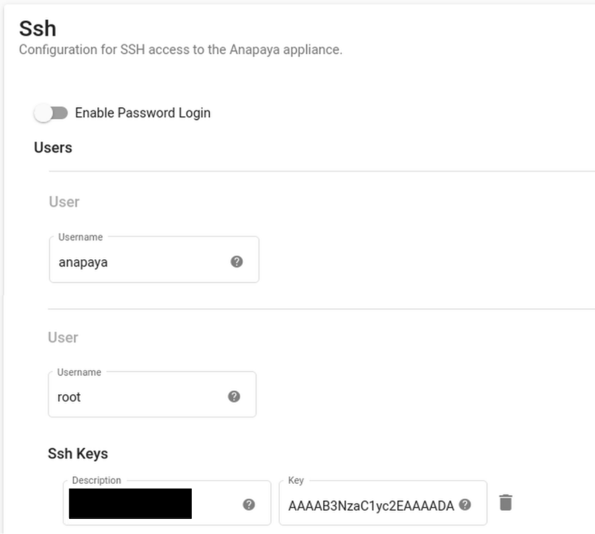

Management System
No (default) authentication!
Every CYD SCION user can:
  Change configuration
  Upload/Install/Delete any packages (binaries)
  Add new TRC
Add/Delete Users + SSH keys
Notes:
raus

Slide 14
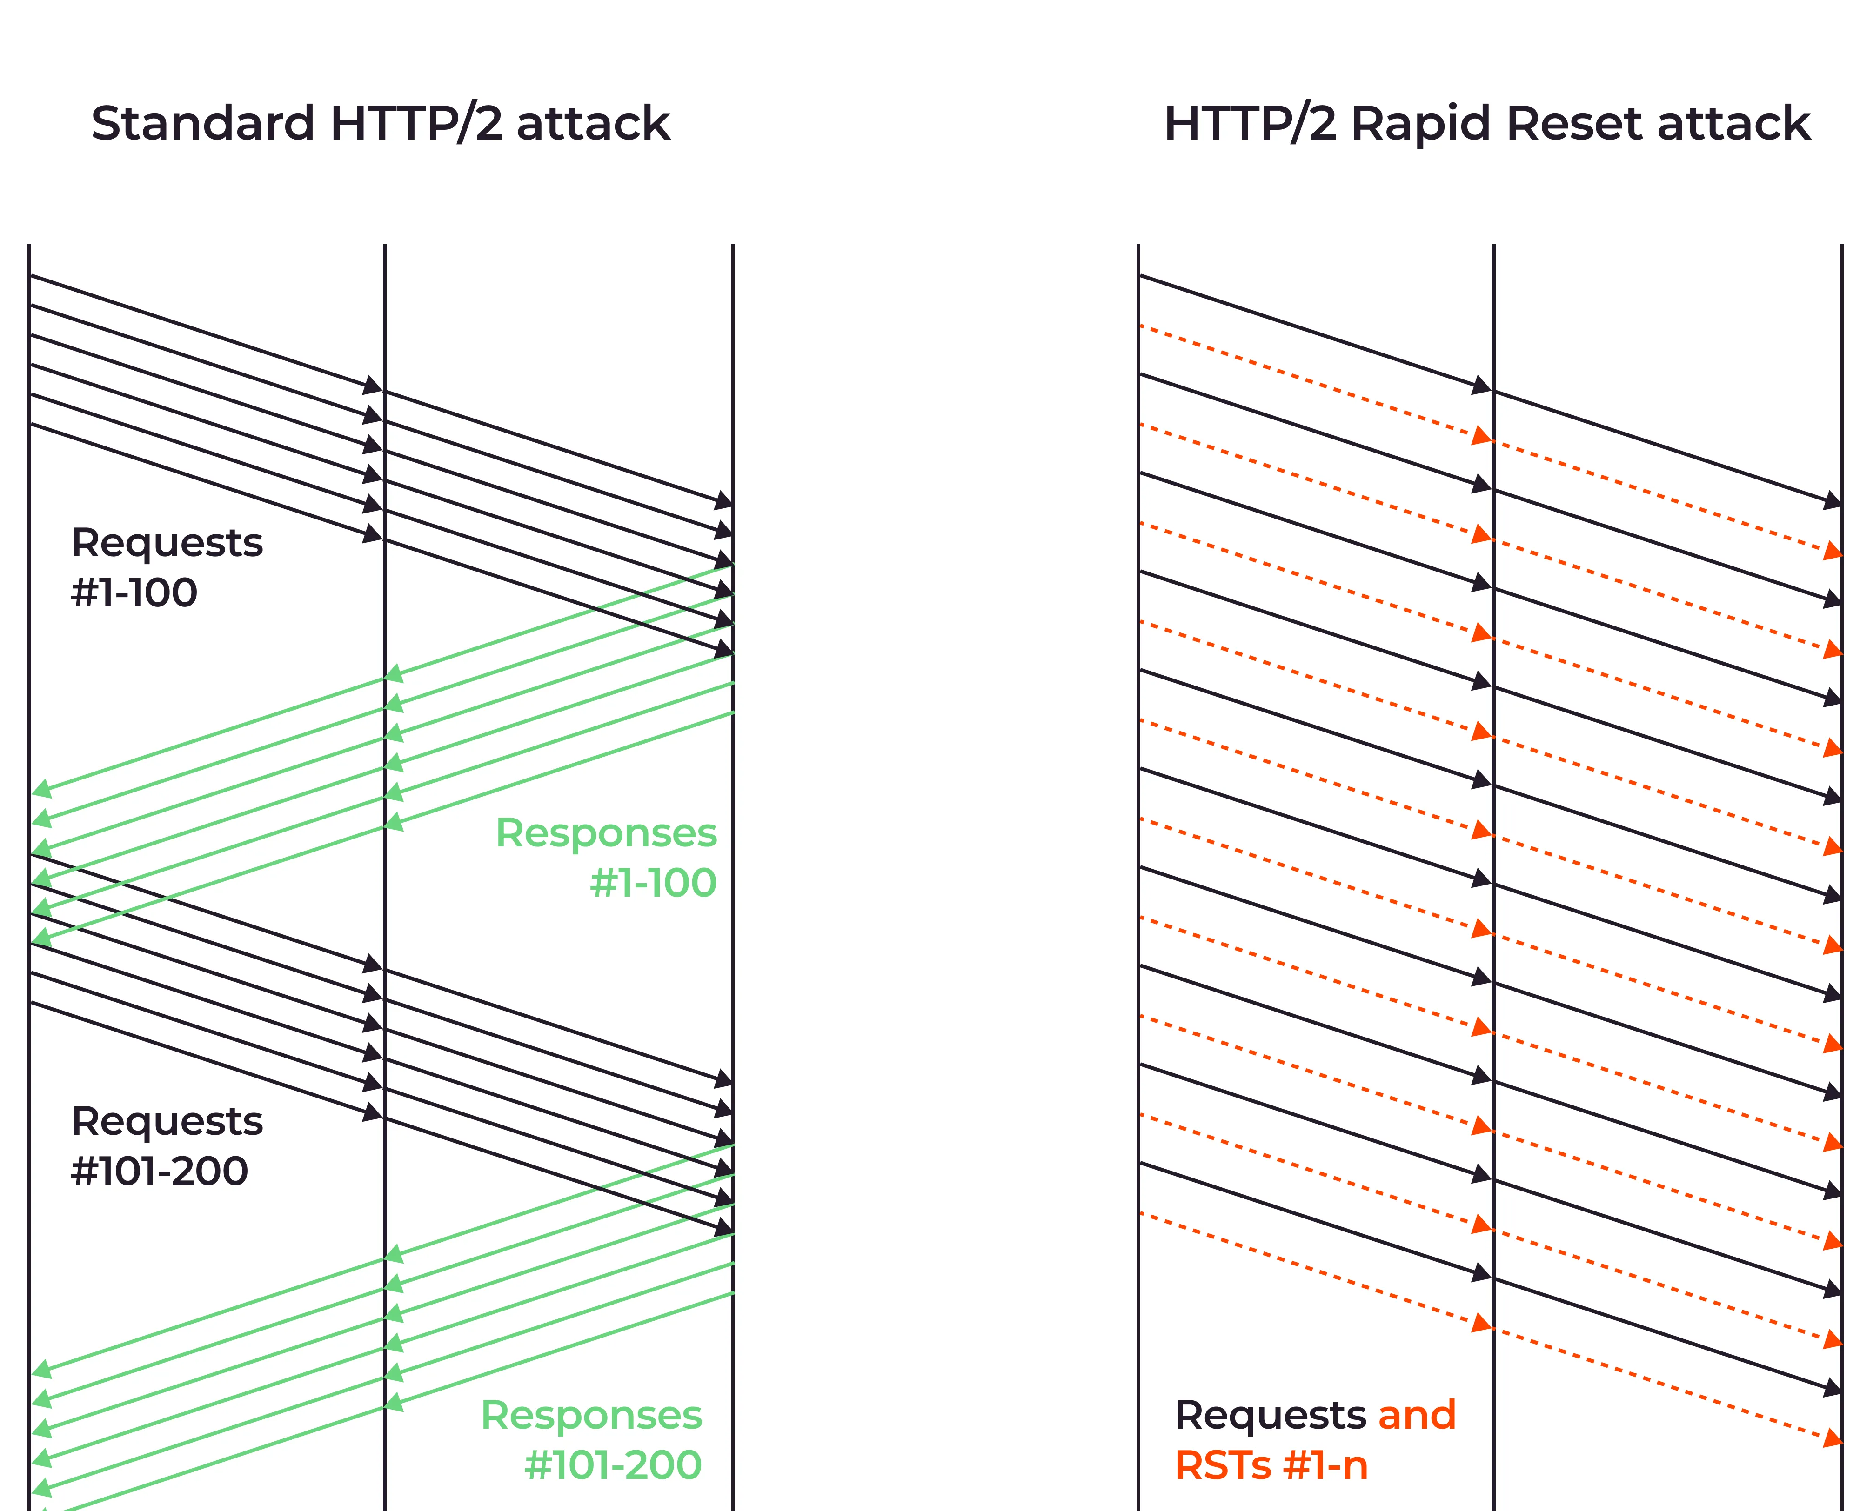

Management System
Webserver (Caddy) vulnerable
HTTP/2 Rapid Reset
Resource exhaustion
Works even with enabled authentication
Demo?
Notes:
raus

Slide 15
2) Anapaya’s SCION protocol

Slide 16


SCION Protocol – Anapaya Version
Cryptography
  Hop Field MAC - Algorithm
  Source Authentication – DRKey
Packet Manipulation
  Field/header modifications
  Path modification (Path splicing, path extension)
  Spoofing
Notes:
Operational devices

Slide 17
Cryptography
Hop Field MAC
  Anapaya == Open-source (AES-CMAC)
  Master Secret (used to derive MAC key) fixed
  → never refreshed
DRKey
  Not enabled/available
  → No source authentication (SPAO) possible
  Unauthenticated SCMP error messages
Notes:
Operational devices

Slide 18

AS:12350
SWITCH
AS: 559
AS:15623
Swisscom
AS: 3303
Path splicing: Combine hops of different paths
Sunrise
AS: 6730
Zurich AS:
2:0:2b
Thun AS:
2:0:2c
Lausanne AS:
2:0:2d
Notes:
Not working → MAC check
Resultat weg

Slide 19

SWITCH
AS: 559
Swisscom
AS: 3303
Sunrise
AS: 6730
Source Address Spoofing
No AS/Address filtering
If destination performs path-lookup → Works
Can we force path-lookup?
Zurich AS:
2:0:2b
SRC: 2:0:2c
DST: 2:0:2d
Thun AS:
2:0:2c
SRC: 2:0:2d
DST: 2:0:2c
Lausanne AS:
2:0:2d
Notes:
Nur test setup keine resultate

Slide 20

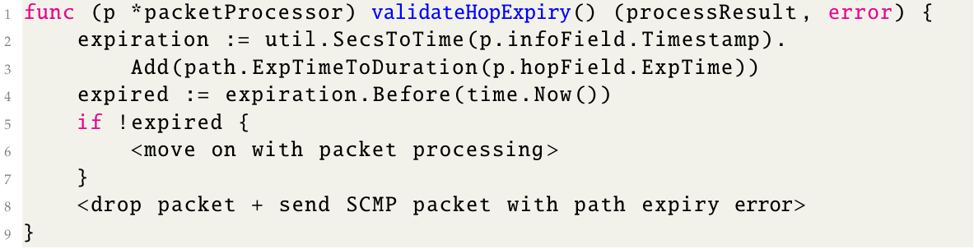
Spoofing
Force path lookup with soon-to-expire paths
Feasibility depends on application
Valid path information got rejected (30s before actual expiry)

Slide 21

3) Internet Impact on SCION

Slide 22
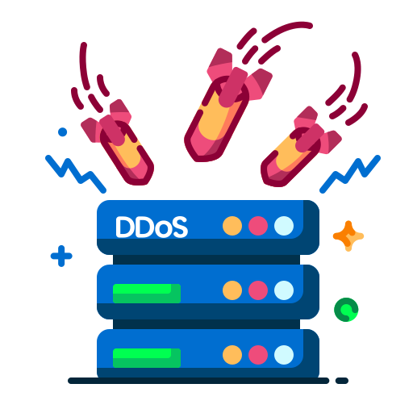

Volumetric Denial of Service
Traditional Internet → Impact on SCION
SWITCH
40 Gbps
10 Gbps
ETH
CYD
40 Gbps
10 Gbps
Notes:
Nur test setup keine resultate

Slide 23

Conclusion
Security Analysis:
  Devices
  Protocol
  Impact Internet
Anapaya fixed most of the shortcomings
Future work:
  Other Anapaya products
  Control plane
  Deployment

